Slide 1

lesson 1
  An Overview of the Computer System

Slide 2
This lesson includes the following sections:
    The Parts of a Computer System
    Looking Inside the Machine
    Software: Bringing the Machine to Life

Slide 3
The Parts of a Computer System
  What is a Computer?
  Hardware
  Software
  Data
  Users

Slide 4
The Parts of a Computer System
- What is a Computer?
A computer is an electronic device used to process data.
A computer can convert data into information that is useful to people.
A complete computer system includes four distinct parts:
    Hardware
    Software
    Data
    User

Slide 5
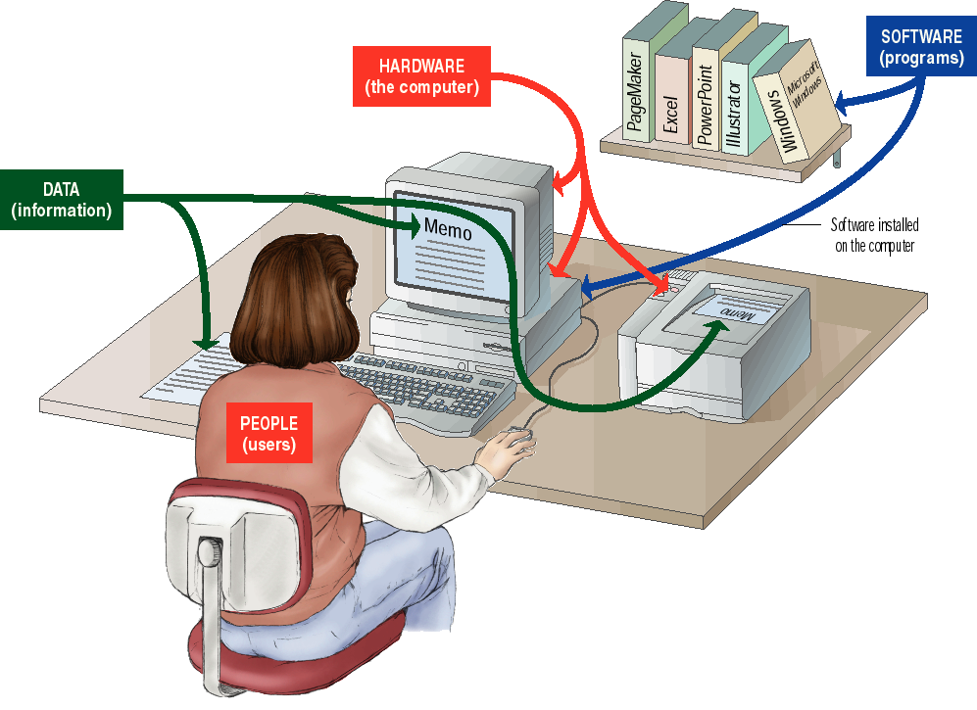

Slide 6
The Parts of a Computer System - Hardware
A computer's hardware consists of electronic devices; the parts you can see and touch.
The term "device" refers to any piece of hardware used by the computer, such as a keyboard, monitor, modem, mouse, etc.

Slide 7
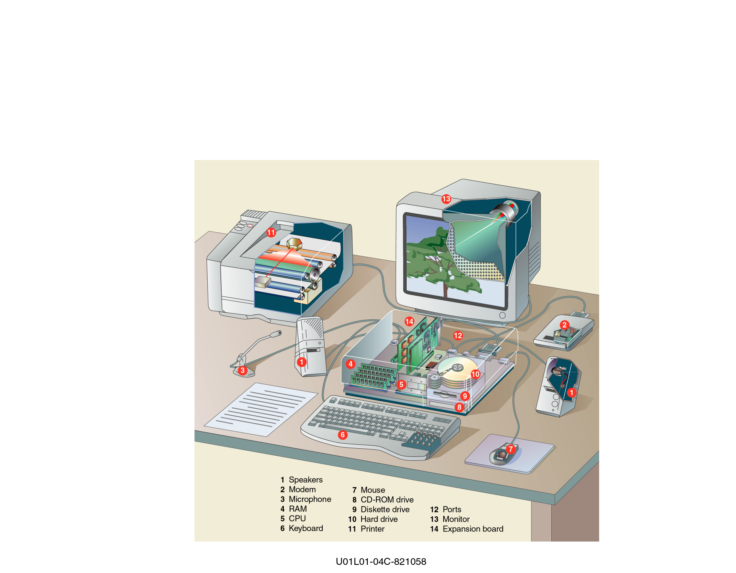

Slide 8
The Parts of a Computer System - Software
  Software – also called programs – consists of organized sets of instructions for controlling the computer.
  Some programs exist for the computer's use, to help it manage its own tasks and devices.
  Other programs exist for the user, and enable the computer to perform tasks for you, such as creating documents.

Slide 9
The Parts of a Computer System - Data
Data consists of raw facts, which the computer can manipulate and process into information that is useful to people.
Computerized data is digital, meaning that it has been reduced to digits, or numbers. The computer stores and reads all data as numbers.
Although computers use data in digital form, they convert data into forms that people can understand, such as text, numerals, sounds, and images.

Slide 10
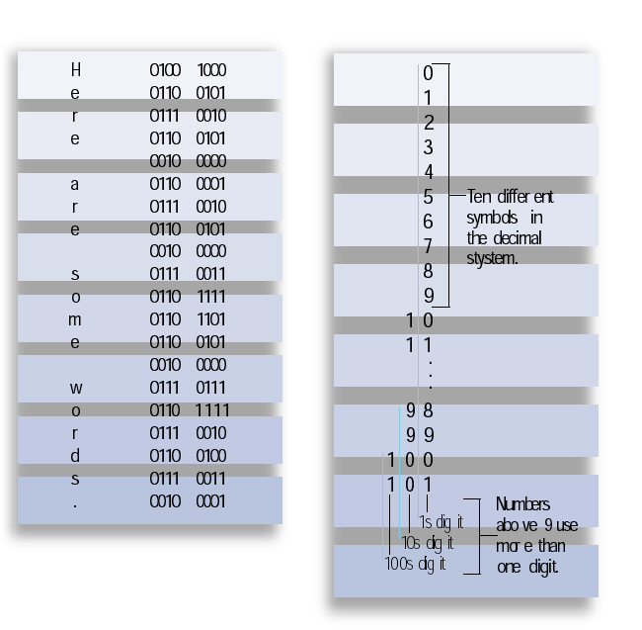
Ten different
symbols in
the decimal
system
Numbers above 9
use more than 1 digit

Slide 11

The Parts of a Computer System – Users
People are the computer's operators, or users.
Some types of computers can operate without much intervention from people, but personal computers are designed specifically for use by people.

Slide 12
Looking Inside the Machine
  Types of Hardware
  The CPU
  Memory
  How Memory is Measured
  Input and Output Devices
  Storage Devices

Slide 13
Looking Inside the Machine –
Types of Hardware
A computer's hardware devices are categorized as follows:
    Processor
    Memory
    Input and output (I/O) devices
    Storage devices

Slide 14
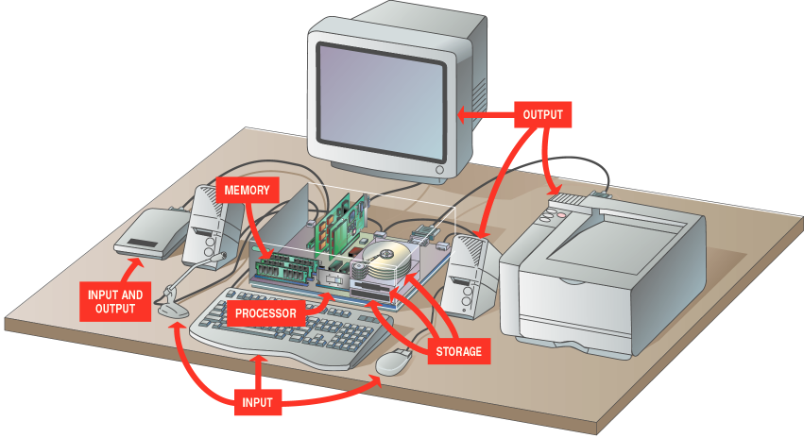

01101111
10001111
01101010
10000000
01001010

Slide 15
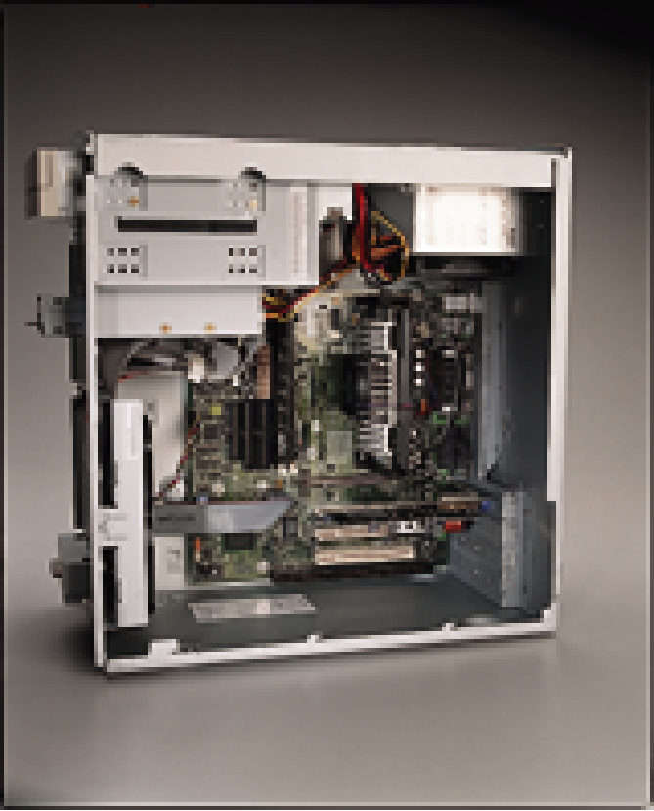
Looking Inside the Machine - The CPU
  The procedure that transforms raw data into useful information is called processing. This function is divided between the computer's processor and memory.
  The processor is also called the central processing unit (CPU). It manages all devices and performs the actual processing of data.
  The CPU consists of one or more chips attached to the computer's main circuit board (the motherboard).

Slide 16
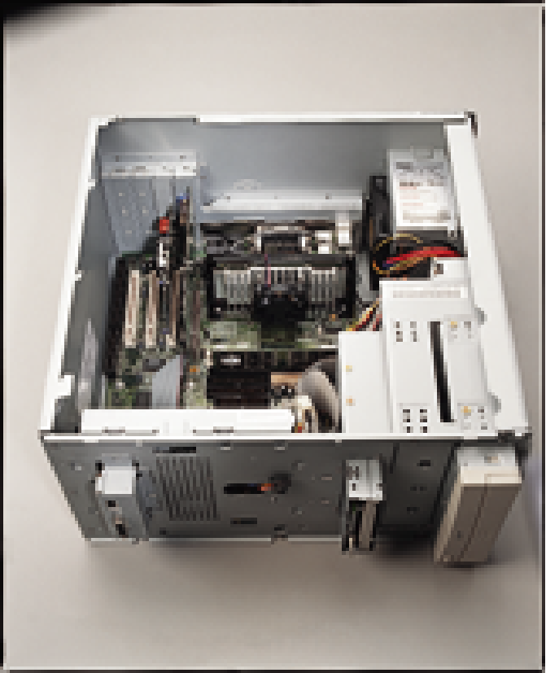
Looking Inside the Machine - Memory
  Memory also consists of chips attached to the motherboard.
  Memory holds data and program instructions as the CPU works with them. This memory is called Random Access Memory (RAM).
  The CPU can find any piece of data
  in RAM, when it needs it for processing.
  RAM is volatile, meaning it holds data
  only when the power is on. When the power
  is off, RAM's contents are lost.

Slide 17
Looking Inside the Machine
– How Memory is Measured
The smallest usable unit of measure for memory is the byte – the amount of memory required to hold one character, like the letter A or the numeral 2.
Computers work with larger chunks of data, measured in multiple bytes, as shown below:
Unit Approx. Value Actual Value
(bytes) (bytes)
Kilobyte (KB) 1,000 1,024
Megabyte (MB) 1,000,000 1,048,576
Gigabyte (GB) 1,000,000,000 1,073,741,824
Terabyte (TB) 1,000,000,000,000 1,099,511,627,776

Slide 18
Looking Inside the Machine –
Input and Output Devices
Input devices accept data and instructions from the user or from another computer system. The keyboard and mouse are examples of input devices.
Output devices return processed data back to the user or to another computer system. The printer and monitor are examples.
Communications devices (such as modems and network interface cards) perform both input and output, allowing computers to share information.

Slide 19
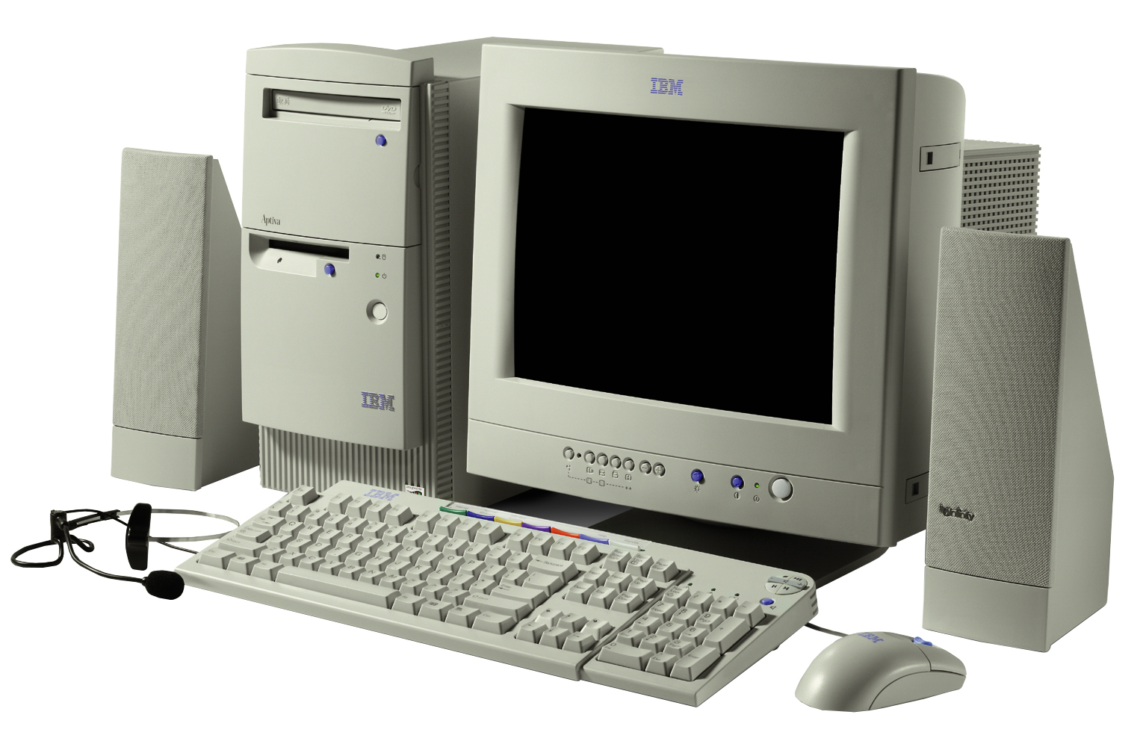

Slide 20
Looking Inside the Machine - Storage Devices
Storage devices hold data not currently being used by the CPU. Data is commonly stored on a magnetic or optical disk. Each type uses a special medium for storing data on its surface.
A disk drive is a device that reads data from and writes data to a disk. Most new computers feature a floppy disk drive, a hard disk drive, and an optical disk drive.
The most common optical storage devices are CD-ROM and DVD-ROM drives.

Slide 21
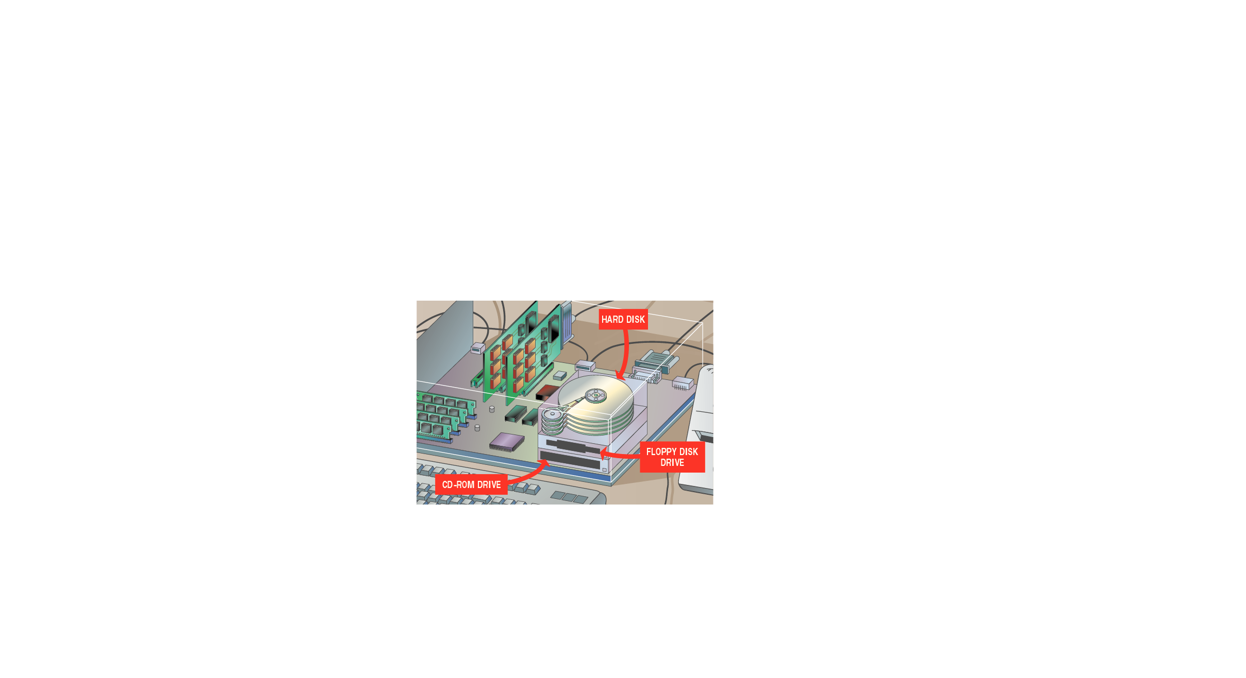

Slide 22
Software: Bringing the Machine to Life
What is Software?
System Software
Application Software

Slide 23
Bringing the Machine to Life –
What is Software?
  Software is a set of electronic instructions that tells the computer how to do certain tasks. A set of instructions is often called a program.
  When a computer is using a particular program, it is said to be running or executing the program.
  The two most common types of programs are system software and application software.

Slide 24
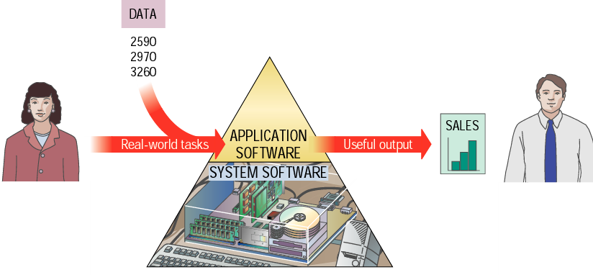

Slide 25
Bringing the Machine to Life –
System Software
System software exists primarily for the computer itself, to help the computer perform specific functions.
One major type of system software is the operating system (OS). All computers require an operating system.
The OS tells the computer how to interact with the user and its own devices.
Common operating systems include Windows, the Macintosh OS, OS/2, and UNIX .

Slide 26
Bringing the Machine to Life - Applications
Application software tells the computer how to accomplish tasks the user requires, such as creating a document or editing a graphic image.
Some important kinds of application software are:
Word processing programs Spreadsheet software
Database management Presentation programs
Graphics programs Networking software
Web design tools and browsers Internet applications
Communications programs Utilities
Entertainment and education Multimedia authoring

Slide 27
lesson 1 review
List the four parts of a computer system.
Identify four types of computer hardware.
List five units of measure for computer memory and storage.
Provide two examples of input and output devices.
Name and describe three types of storage devices.
Differentiate the two main categories of computer software.
List four specific types of application software.

